Slide 1


Accessibility and Usability
Jorge Morales Llerandi
Carlos Santana Esplá

Slide 2
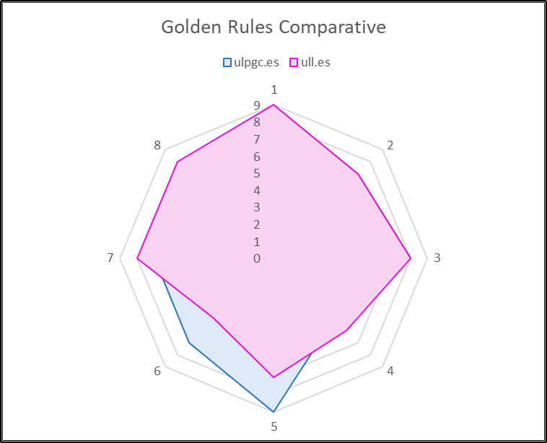
Jorge’s opinion
GOLDEN RULES | ULPGC | ULL
1. Strive for Consistency | 7 | 9
2. Seek Universal Usability | 7 | 7
3. Offer Informative Feedback | 8 | 8
4. Design Dialogues to Yield Closure | 5 | 6
5. Prevent Errors | 9 | 7
6. Permit Easy Reversal | 7 | 5
7. Keep Users in Control | 7 | 8
8. Reduce Short-Term Memory Load | 8 | 8

Slide 3
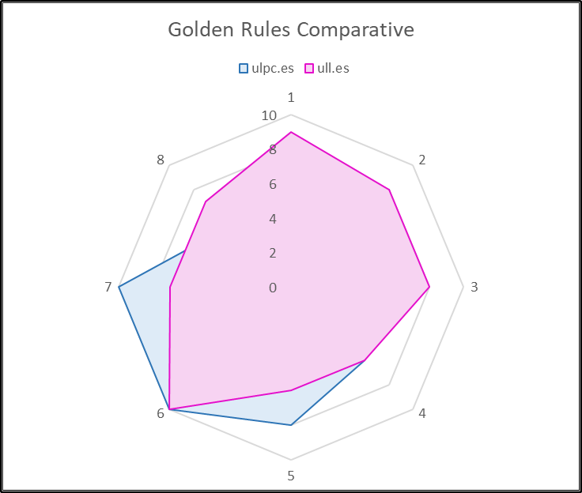
Carlos’s opinion
GOLDEN RULES | ULPGC | ULL
1. Strive for Consistency | 6 | 9
2. Seek Universal Usability | 8 | 8
3. Offer Informative Feedback | 6 | 8
4. Design Dialogues to Yield Closure | 6 | 6
5. Prevent Errors | 8 | 6
6. Permit Easy Reversal | 10 | 10
7. Keep Users in Control | 10 | 7
8. Reduce Short-Term Memory Load | 5 | 7

Slide 4
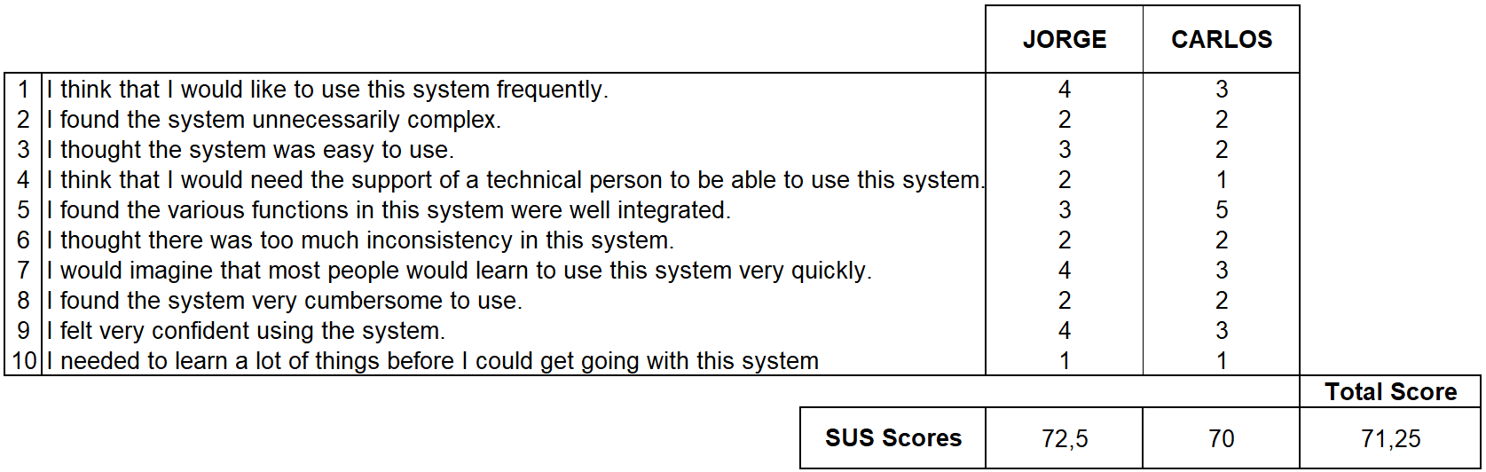
Conclusion

